Slide 1
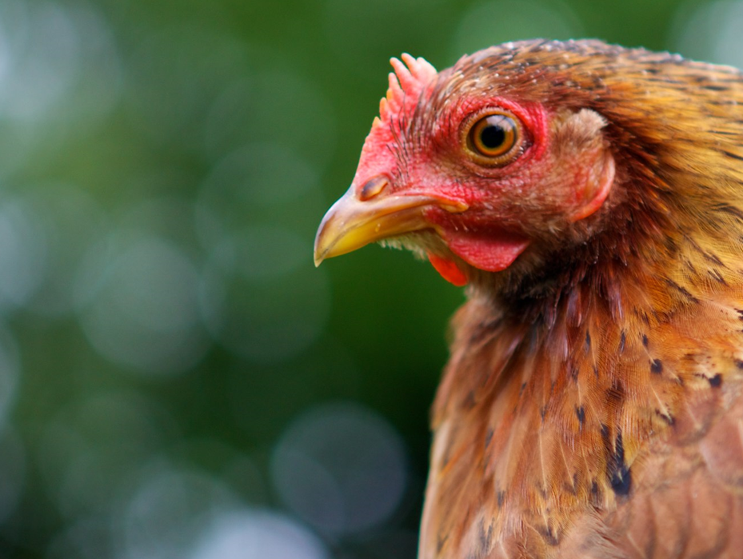
Group work
WOAH
26 – 28 August 2025
WOAH Regional Representation for Asia and the Pacific
Sapporo, Japan

Slide 2
Agenda
Time | Activities
09:00 - 09:15 | Instruction
09:15 – 11:15 | Breakout room for group discussion
 | *Coffee serves at 10:30
11:20 – 12:10 | Group presentations (10 min x 5 groups)
12:10 – 12:30 | Plenary
12:30 – 13:30 | Lunch

Slide 3
Global strategy for the prevention and control of HPAI
Objective 1: Prevent HPAI epizootics, panzootics and negative impacts on human health and ecosystems through multisectoral early detection and control
  Output 1.1: Avian influenza risk monitoring and risk-based surveillance in domestic and wild animals supported and information shared across sectors at the national, regional and global levels
  Output 1.2: Laboratory diagnostic capacities for early detection, differentiation and identification of avian influenza viruses established and supported
  Output 1.3: One Health collaborative preparedness and response capacities to control HPAI outbreaks promoted
Objective 2: Protect poultry value chains, livelihoods, trade and the health of humans, animals and ecosystems from HPAI impacts
  Output 2.1: Biosecurity and other approaches to reduce HPAI risks along the poultry value chain and at the domestic animal–wildlife–human interface developed and promoted
  Output 2.2: HPAI vaccination stewardship guidance aligned to international standards developed and widely communicated
  Output 2.3: Guidance, training and advocacy tools are developed, shared and implemented to promote the development of infection-free value chains and safe trade
Objective 3: Transform poultry value chains to improve resilience to HPAI and other disease threats
  Output 3.1: One Health and private–public partnerships, policy and legal frameworks and responsible investments promoted for building safe, resilient and sustainable poultry value chains
  Output 3.2: Inter- and intraregional and context-specific knowledge sharing on risk management facilitated
  Output 3.3: National strategies for ensuring sustainable, effective public and private veterinary services promoted
  Output 3.4: Transformative research such as the development of mass-applied HPAI vaccines and a novel surveillance system to provide an evidence base for policy change encouraged and supported

Slide 4
Grouping
 | East Asia | South Asia | Southeast Asia (a) | Southeast Asia (b) | Pacific
Room | Conference room – left | Conference room – right | Main hall | Lunchroom – front | Lunchroom - back
Facilitators | Y. Moribe B. Purevsuren | G. Pavade | H. Kugita S. Castro | N. Ketusing L. Thompson | T. Patanasatienkul E. Borja
Members | China (P.R.) Chinese Taipei Japan Korea (ROK) Mongolia | Bangladesh Bhutan India Iran Nepal Pakistan Sri Lanka | Malaysia Myanmar Singapore Vietnam | Laos Indonesia Philippines Thailand | Australia Fiji New Caledonia New Zealand PNG Vanuatu

Slide 5
Groups
Group | Room | Reference lab | Facilitators
East Asia | Main hall – left | Y. Sakoda | Y. Moribe, B. Purevsuren
South Asia | Main hall – right | C. Tosh | G. Pavade
Southeast Asia (a) | Main hall – back | F. Saeid | H. Kugita, S. Castro
Southeast Asia (b) | Lunch room – front | H. Irianingsih | N. Ketusing, L. Thompson
Pacific | Lunch room – back | F. Wong | T. Patanasatienkul, E. Borja

Slide 6
Strengthening capacities for avian disease prevention and control
[add group name]

Slide 7
Output 1.1: Avian influenza risk monitoring and risk-based surveillance in domestic and wild animals supported and information shared across sectors at the national, regional and global levels
Gaps/needs | Activities

Slide 8
Output 1.2: Laboratory diagnostic capacities for early detection, differentiation and identification of avian influenza viruses established and supported
Gaps/needs | Activities

Slide 9
Output 1.3: One Health collaborative preparedness and response capacities to control HPAI outbreaks promoted
Gaps/needs | Activities

Slide 10
Output 2.1: Biosecurity and other approaches to reduce HPAI risks along the poultry value chain and at the domestic animal–wildlife–human interface developed and promoted
Gaps/needs | Activities

Slide 11
Output 2.2: HPAI vaccination stewardship guidance aligned to international standards developed and widely communicated
Gaps/needs | Activities

Slide 12
Output 2.3: Guidance, training and advocacy tools are developed, shared and implemented to promote the development of infection-free value chains and safe trade
Gaps/needs | Activities

Slide 13
Objective 3: Transform poultry value chains to improve resilience to HPAI and other disease threats
Output | Gaps/needs | Activities

Slide 14
Thank you

